Slide 1
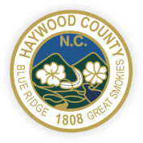
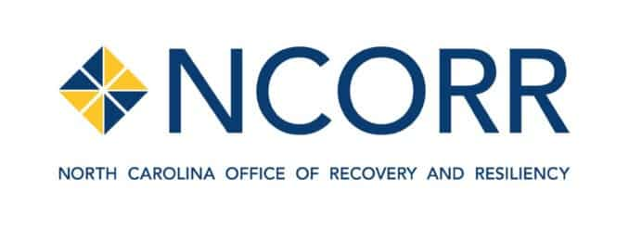
Affordable Housing Development Fund
Notes:
1 Beds start at $576 and 3 beds max out at $1,197

Slide 2
Workforce Housing Need
Haywood County 3rd fastest growing in region 2010-20¹
Minimum $49,480 income (almost $24/hour) to afford 2-bedroom apartment²
  52% of Haywood renters cost-burdened
  20% spending over 50% of annual gross income on rent
Home prices up 12+% annually³
Median Sales Price
$365,000
12.3%
$325,000
Bowen National Research, 2022
North Carolina Housing Coalition
Haywood Chamber of Commerce

Slide 3
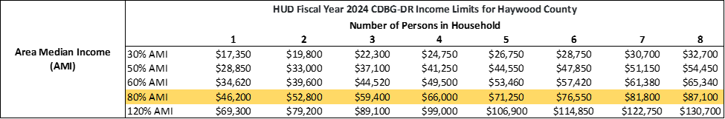
Area Median Income for Haywood County
Low Moderate Income (LMI): 80% AMI or lower
Notes:
2024 Median Family Income for Haywood County (HUD) : $83,400

Slide 4

Mountain Housing Opportunities: Balsam Edge
Project: 84 units,
  100% of the units will be set aside for LMI individuals.
    14% of the units will be set aside for individuals with physical impairments.
    2% of the units will be equipped with features for individuals with sight or hearing impairments.
Projected Timeline: Q4 2024 through Q4 2026
Ask: $3.5 Million of $21.5 Million total project cost
Final Environmental & Architectural Review
Notes:
1 Beds start at $576 and 3 beds max out at $1,197

Slide 5
Mountain Housing Opportunities: Balsam Edge
Existing Funding Sources
Dogwood Health Trust Grant: Acquisition of the property
Town of Waynesville Sewer Grant: An in kind grant allocation from the town to cover the cost of extending a sewer infrastructure to the property
Pigeon River Fund Grant: A grant to amplify the constructed wetland stormwater amenity
USDA Permanent Financing: MHO is working with Bellwether Enterprise to utilize a USDA 538 loan as permanent financing
North Carolina Housing Finance Agency (NCHFA): A Rental Production Program Loan- A soft, cashflow loan serving as soft mezzanine financing

Slide 6
Mountain Housing Opportunities: Balsam Edge
Existing Funding Sources
Low Income Housing Tax Credit (LIHTC) Equity: MHO was awarded a competitive 9% LIHTC, awarded a one-time bonus point aimed towards aiding Haywood County from the effects of Tropical Storm Fred
“With these matching funds in the current capital stack, for every dollar of CDBG-DR funding in Balsam Edge, $5.14 of other sources will be leveraged.”

Slide 7




Mountain Housing Opportunities: Balsam Edge
Letters of Support

Slide 8

Mountain Projects: Harkins Avenue
Project: 23 units,
Projected Timeline: Q2 2025 through Q3 2027
Ask: $2.5 Million of $10.2 Million total project cost
Complete: Phase 1 environmental review
Conditions:
  Zoning variance
  Restrictive covenants
  Deed Restrictions
Notes:
Cost: 197,000 for 2 Bed to 240,000 for 3 Bed

Slide 9
Mountain Projects: Harkins Avenue
Existing Funding Sources
Dogwood Health Trust has committed to paying for phase I and II of environmental reports
  McGill has completed the phase I environmental report
Dogwood Health Trust Grant for the acquisition of the property in September 2021

Slide 10
Mountain Projects: Harkins Avenue
Existing Funding Sources
USDA Self-Help Housing: Is an owner-built “sweat equity” program for first time homeowners, supervised by a construction supervisor.
  The “sweat-equity” is often counted as part of the homeowner’s down payment or equity in the home.
The USDA Self-Help Program is helping fund admin capacity, a construction supervisor & assistants, training, and equipment.

Slide 11




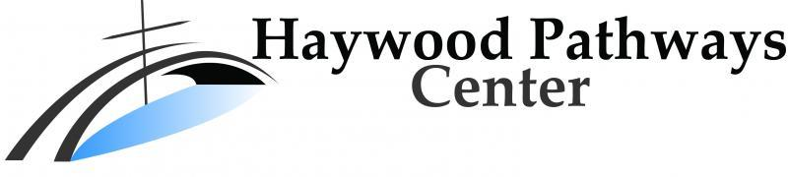
Mountain Projects: Harkins Avenue
Letters of Support

Slide 12
Special Thanks To:
NCORR Team
Evaluation Panel
Haywood County Team
Any Questions?

