Slide 1


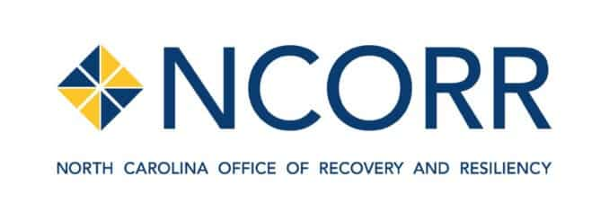
Request Approval of Developer Agreement for Balsam Edge
Notes:
1 Beds start at $576 and 3 beds max out at $1,197

Slide 2

Mountain Housing Opportunities: Balsam Edge
Project: 84 units,
100% of the units will be set aside for LMI individuals.
14% of the units will be set aside for individuals with physical impairments.
2% of the units will be equipped with features for individuals with sight or hearing impairments.
Projected Timeline: Q3 2025 through Q1 2027
Ask: $3.5 Million of $25.3 Million total project cost
Received Authority to Use Grant Funds (AUGF) from HUD, end of March 2024
Notes:
1 Beds start at $576 and 3 beds max out at $1,197

Slide 3
Mountain Housing Opportunities: Balsam Edge Existing Funding Sources
Low Income Housing Tax Credit (LIHTC) Equity: MHO was awarded a competitive 9% LIHTC, awarded a one-time bonus point aimed towards aiding Haywood County from the effects of Tropical Storm Fred
“With these matching funds in the current capital stack, for every dollar of CDBG-DR funding in Balsam Edge, $7.22 of other sources will be leveraged.”

Slide 4
Mountain Housing Opportunities: Balsam Edge Existing Funding Sources
Dogwood Health Trust Grant: Acquisition of the property
Town of Waynesville Sewer Grant: An in kind grant allocation from the town to cover the cost of extending a sewer infrastructure to the property
Pigeon River Fund Grant: A grant to amplify the constructed wetland stormwater amenity
USDA Permanent Financing: MHO is working with Bellwether Enterprise to utilize a USDA 538 loan as permanent financing
North Carolina Housing Finance Agency (NCHFA): A Rental Production Program Loan- A soft, cashflow loan serving as soft mezzanine financing

Slide 5




Mountain Housing Opportunities: Balsam Edge Letters of Support

Slide 6
Workforce Housing Need
Haywood County 3rd fastest growing in region 2010-20¹
Minimum $49,480 income (almost $24/hour) to afford 2-bedroom apartment²
52% of Haywood renters cost-burdened
20% spending over 50% of annual gross income on rent
Home prices up 12+% annually³
Median Sales Price
$365,000
12.3%
$325,000
Bowen National Research, 2022
North Carolina Housing Coalition
Haywood Chamber of Commerce

Slide 7
Area Median Income for Haywood County
Low Moderate Income (LMI): 80% AMI or lower
Notes:
2024 Median Family Income for Haywood County (HUD) : $83,400

